Slide 1


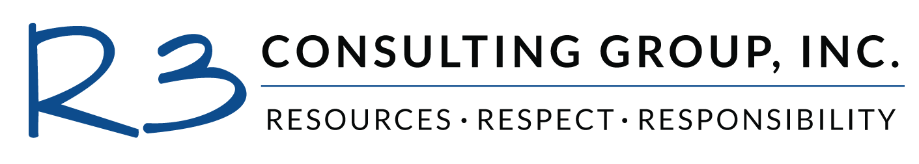
City of Rialto
City Council
April 25, 2023

Slide 2
AGENDA
  Background
  Financial Evaluation

Slide 3
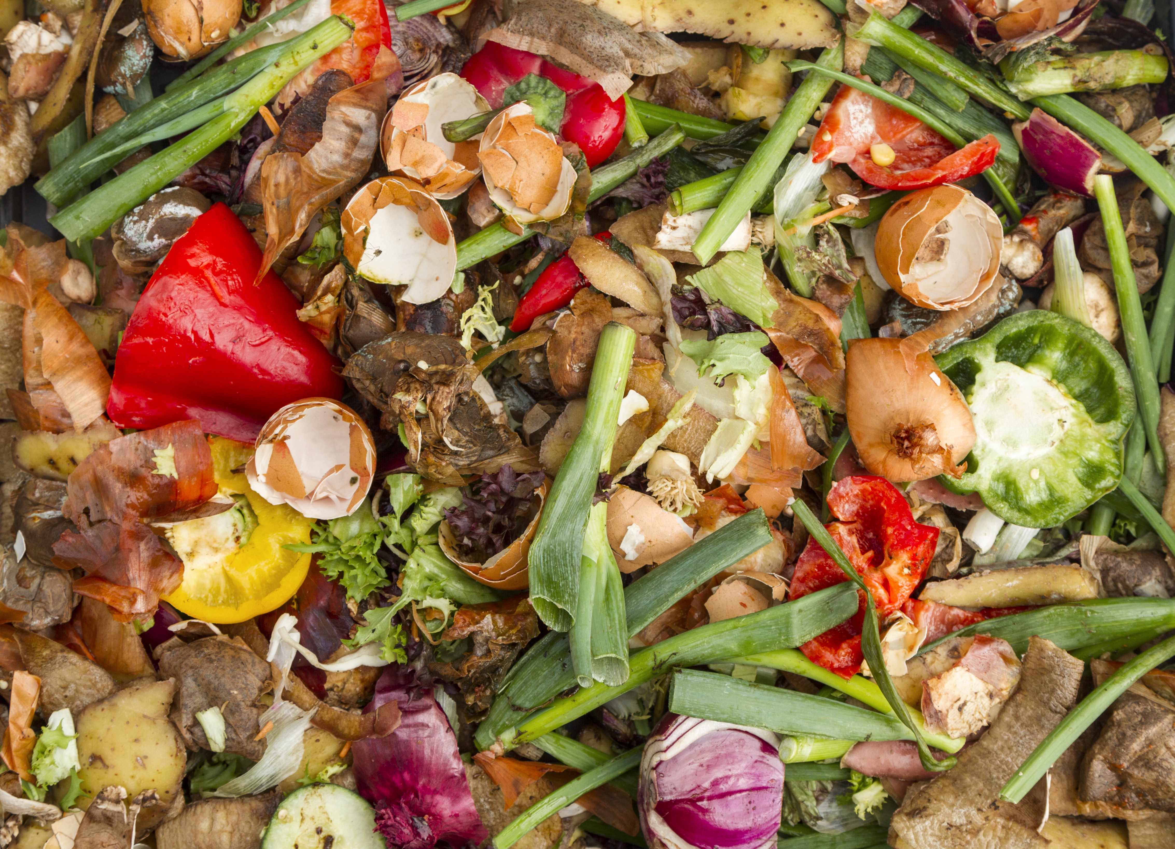
BACKGROUND
Senate Bill (SB) 1383:
WHAT ARE ORGANICS?
Food
Green waste
Landscape & Pruning Organic Textiles Carpets
Paper products
Printing/ Writing paper
Lumber
Wood
Manure
Digestate
Biosolids
Sludges
Sets statewide mandates for organics recovery efforts
Builds on prior law to incrementally reduce disposal of organic waste
Requires all generators to be provided organic waste recycling services
Edible food recovery
City obligated by CalRecycle CAP to meet deadlines
Notes:
Climate change law
Excellent progress so far

Slide 4

BACKGROUND
In California, Millions Are
Food Insecure
California Generates
Approximately
20-23 Million Tons
of Organic Waste
Every Year
?
Non-Organic Waste
?
1 in 8 Californians
1 in 5 Children
?
Edible food
That’s Two-Thirds of Our Waste Stream!
California Throws Away
5.6 Million Tons
of Food Waste Every Year!
Notes:
Climate change law
Excellent progress so far

Slide 5
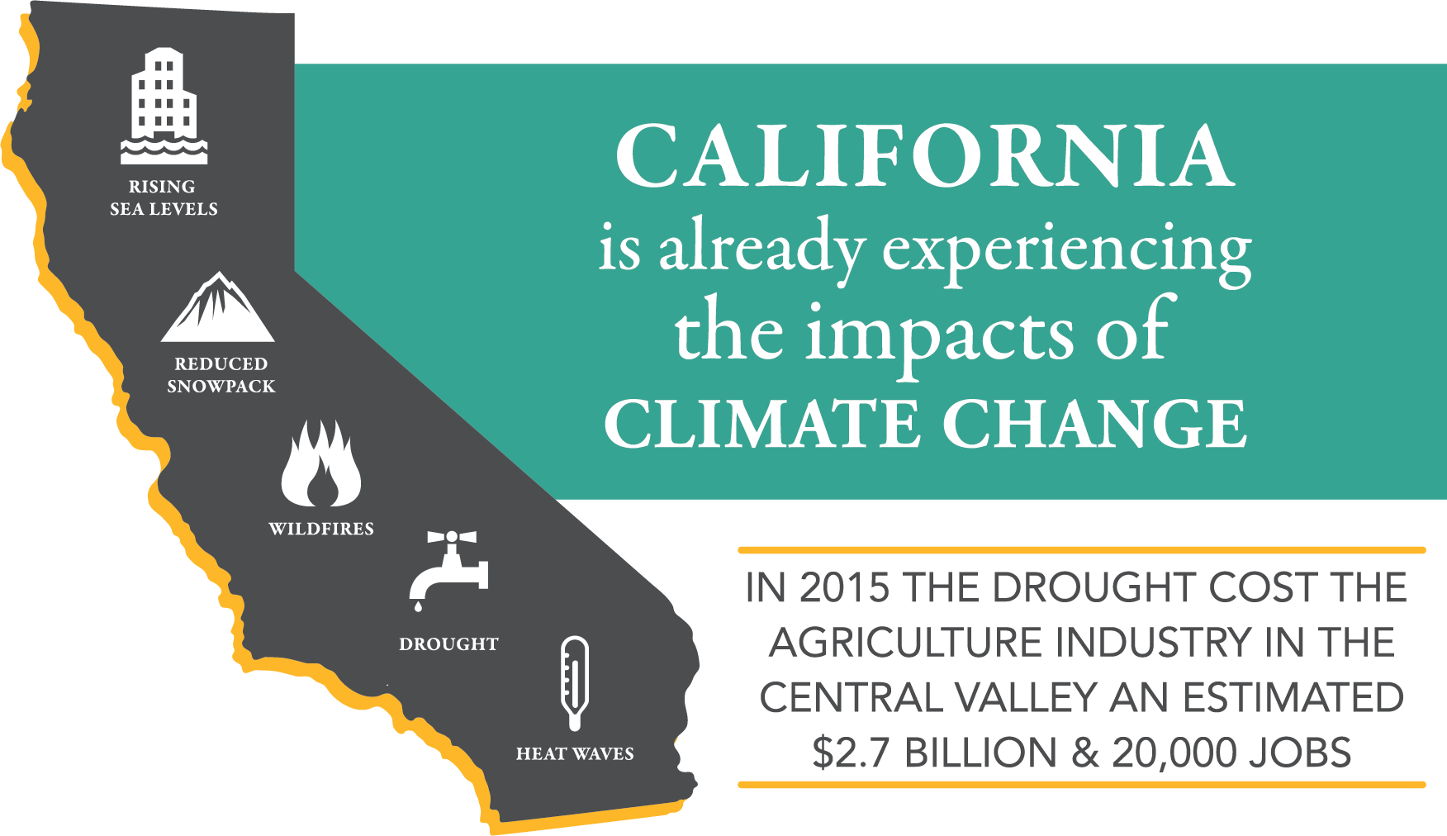
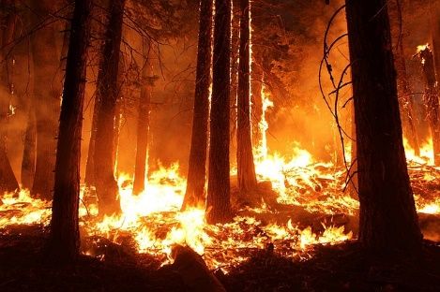
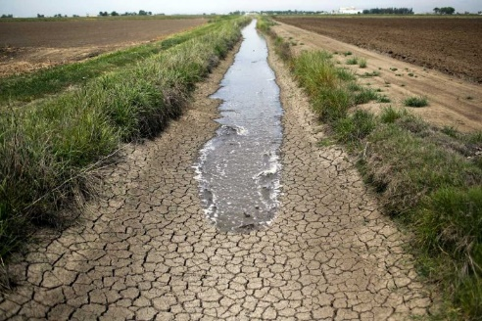
BACKGROUND
Landfilled Organic Waste Emits
Methane Gas
A Super Pollutant
More Powerful than C02
Methane Gas Contributes to
Climate Change in California
Notes:
Climate change law
Excellent progress so far

Slide 6












BACKGROUND
Local Agency Responsibilities
Conduct Education & Outreach to Community
Secure Access to Edible and Recycling Food Recovery Capacity
Provide Organics Collection to All
Establish Edible Food Recovery Program
Procure Recyclable and Recovered Organic Products
Monitor Compliance
and Conduct
Enforcement
Most requirements match and expand upon AB 1826
Notes:
Climate change law
Excellent progress so far

Slide 7
RATE ADJUSTMENT REQUEST
2023 Rate Review Impacts
  Service Consumer Price Index
  Disposal and processing cost components
    Trash, Organics (Green & Food Waste), Recyclables
  Program Impacts
    SB 1383 Compliance and expanding organics recycling amongst all generator sectors
Notes:
6.51% for rates effective January 1, 2020

Slide 8
Recent Rate History
2020 - Defer the 2020/21 adjustment until 2021/22 and include the cost recovery component in the 2021/22 rate year
2021 – Revised to spread residential deferral over two years (2021/2022 & 2022/2023)
2022 - No adjustments; defer adjustments and 2020 residential recovery in 2023
2023 – Implement rate adjustments with 1383 programs

Slide 9
Disposal and Processing
Cost Component (per ton) | Current | New | Change
Trash | $40.75 | $42.07 | $1.32
Organics | $57.29 | $86.96 | $29.67
Recyclables | $66.90 | $71.23 | $4.33
Note: 1) Current Organics tip fee only includes green waste. The New Organics tip fee includes food and green waste materials.
2) Alternative Organics Processing per ton costs:
Victor Valley Compost - $106.58;
Puente Hills MRF - $117.67;
Scholl Canyon - $136.05.

Slide 10
Residential Rates
 | Monthly Charge
Service Level | 2019 | 2020 | 2021 | 2022 | Proposed 2023
60 gallon tax roll | $ 29.96 | $ 29.96 | $ 30.81 | $ 30.81 | $ 34.09
40 gallon tax roll | $ 29.25 | $ 29.25 | $ 30.08 | $ 30.08 | $ 33.32
Senior tax roll | $ 22.74 | $ 22.74 | $ 25.57 | $ 25.57 | $ 28.32
SB 1383 Cost Impacts
Mixed Organics Disposal | SB 1383 Program Costs | Total
$ 1.86 | $ 0.90 | $ 2.76
Note: 1) Residential rates not adjusted in 2020 or 2022
2) Seniors 62 & older

Slide 11
Commercial & Multi-Family Rates
 | Monthly Charge
Commercial Service One time per week | 2021 | Current | Proposed 2023 | Difference
3 yard trash bin (includes no charge recycling) | $262.86 | $235.82 | $238.43 | $2.61
2 yard food waste or trash bin | $196.56 | $178.53 | $182.90 | $4.37
65 gallon Food Waste barrel | $49.47 | $46.97 | $46.07 | ($0.90)
Multi-family 3 yard bin With bulky item collection program | $255.84 | $228.80 | $278.47 | $49.67
Note: 1) Commercial rates not adjusted in 2020 or 2022.
2) MF rates now include the organics recycling program.
3) Pavement Maintenance Fee moratorium April 1, 2023 included in Current Rate

Slide 12
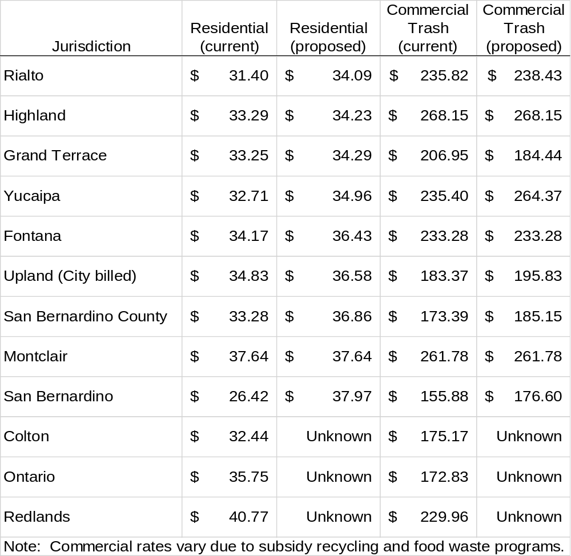
Rate Comparison

Slide 13
RATE ADJUSTMENT REQUEST
Rate increase is reasonable
  10.65% - 10.80% for residential
  -5.86% to 25.13% for commercial
  Based upon only increases to Burrtec’s costs of operation
  City-requested program adjustments via amendment, including hiring additional staff & legislative compliance
Cost savings for economies of scale
Notes:
6.51% for rates effective January 1, 2020

Slide 14
Questions & Comments

