Slide 1
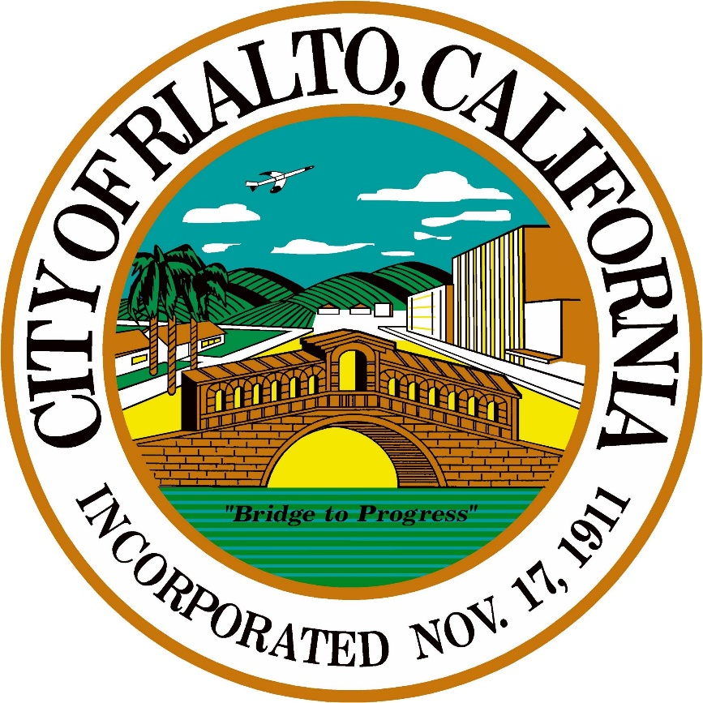
City of Rialto
FISCAL YEAR 2024-2025
Mid year budget update
Council meeting
March 25, 2025

Slide 2
City of Rialto
FY 2024-25 Mid Year Budget Update
Agenda
Update and review through December 31:
General Fund Overview
General Fund YTD Revenue
General Fund YTD Expenses
Department Personnel Requests
Discussion and Council Direction

Slide 3
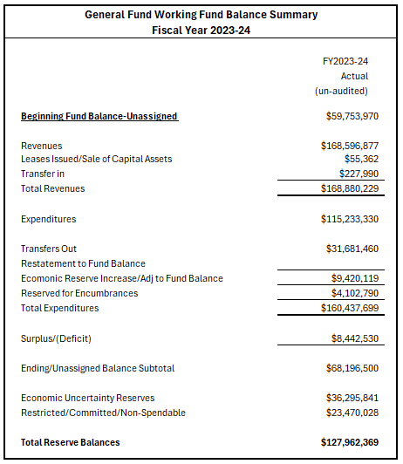
City of Rialto
FY 2024-25 Mid Year Budget Update
General Fund Review
Unrestricted Fund Balance
FY2022-23 - $59,753,970
FY2023-24 - $68,196,500
  Unaudited Preliminary

Slide 4
City of Rialto
FY 2024-25 Mid Year Budget Update
General Fund Reserves
Approximately $68 million at the end of FY 24
$30 million transfer to RUA in FY 25
Potential Restriction of General Fund Reserves:
  $5 million future City Hall
  $10 million toward Capital Improvement Fund
  Other Council Recommendations
Discussion and Council Direction

Slide 5
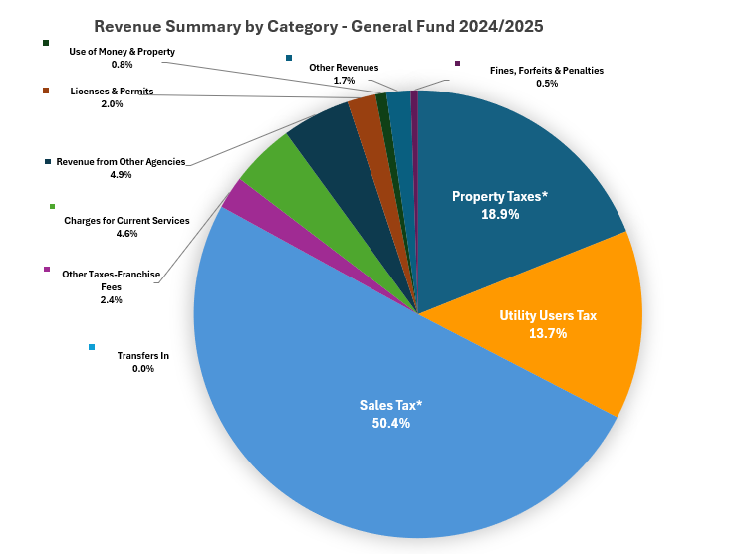
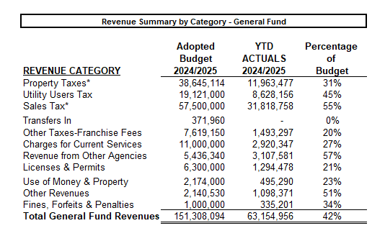
City of Rialto
FY 2024-25 Mid Year Budget Update
FY2024-25 – General Fund Revenue
*Revenues accounting for revenues received following months due to timing to reflect accurately

Slide 6
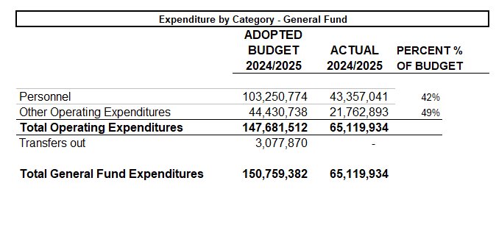
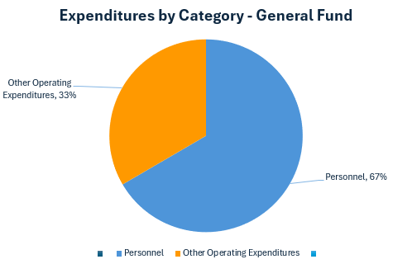
City of Rialto
FY 2024-25 Mid Year Budget Update
FY2024-25 – General Fund Expenses
Personnel – 67%
Other Operating Expenditures– 33%

Slide 7
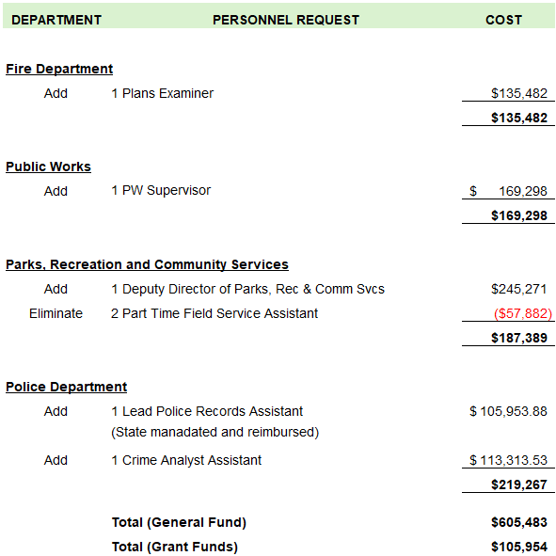
City of Rialto
FY 2024-25 Mid Year Budget Update
Department Personnel Requests

Slide 8
City of Rialto
FY 2024-25 Mid Year Budget Update
Conclusion
Audit firm on site March
Final 2023-24 report expected May
Questions and discussion
Further Direction and Next Steps
  New positions
Coming Soon
Fiscal Year 2025-2026 Budget Workshop & Preparation

