Slide 1

2022 Engineering and Traffic Survey (E&TS)
City Council
February 28, 2023

Slide 2
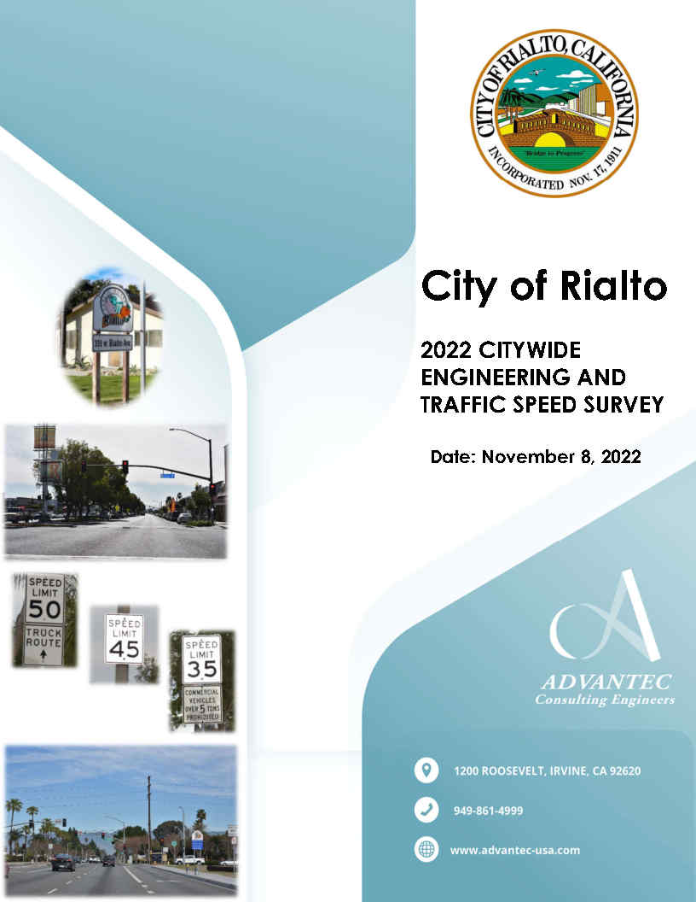
2022 Engineering and Traffic Survey (E&TS)
Speed survey locations
  Radar speed survey (177 roadway segments)
  Both direction of travel
  Collision history
  Daily counts
85th percentile speeds
Recertify existing speed limits
Recommend reclassifying roadway segments from Collector to Local Street
Final Recommended Speed Limits

Slide 3
Criteria for Recertification & Roadway Reclassification
Recertify existing speed limits
  Recommended to extend or recertify existing speed surveys up to 14 years that meets their criteria
  Other criteria may be used once an online tool is created
Recommend reclassifying roadway segments from Collector to Local Street
  “Residence District” pursuant to CVC Section 515 where there are at least 13 homes on one side of the street within ¼ mile, or at least 16 homes total on both sides of the street within ¼ mile. Pursuant to CVC 22352, the speed limit on a residential collector roadway within a residence district is declared at 25 mph.

Slide 4
E&TS Summary
Results: 177 Speed Survey Segments
Recommend Recertifying to 14 years | Recommended Collector to Local (Prima Facie 25 MPH) | Decrease | Increase | No Changes | Newly Established Speeds
32 | 17 | 31 | 11 | 85 | 18

Slide 5
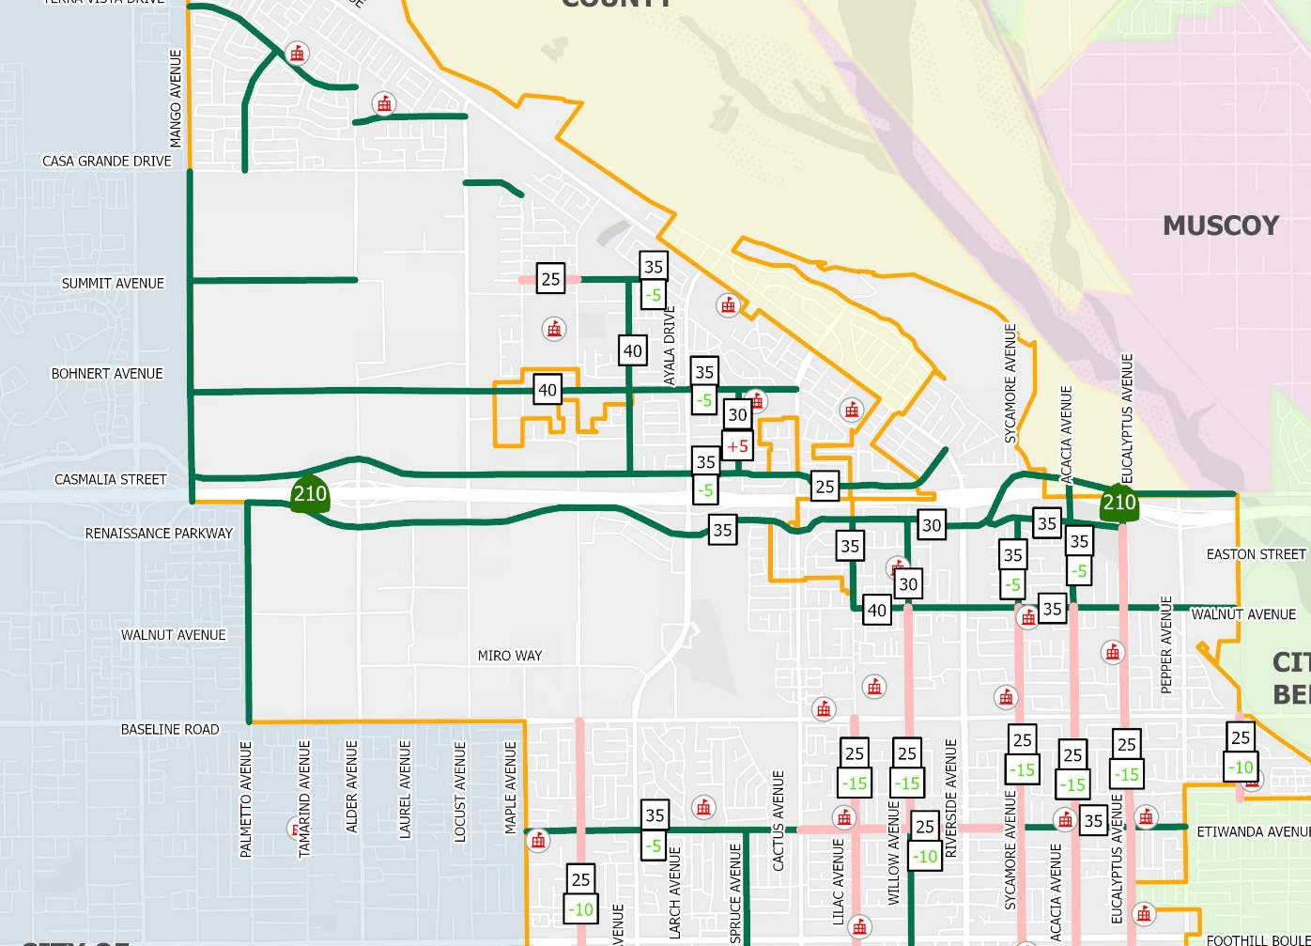

Recommend Collector to Local Street
North of
Etiwanda Ave

Slide 6
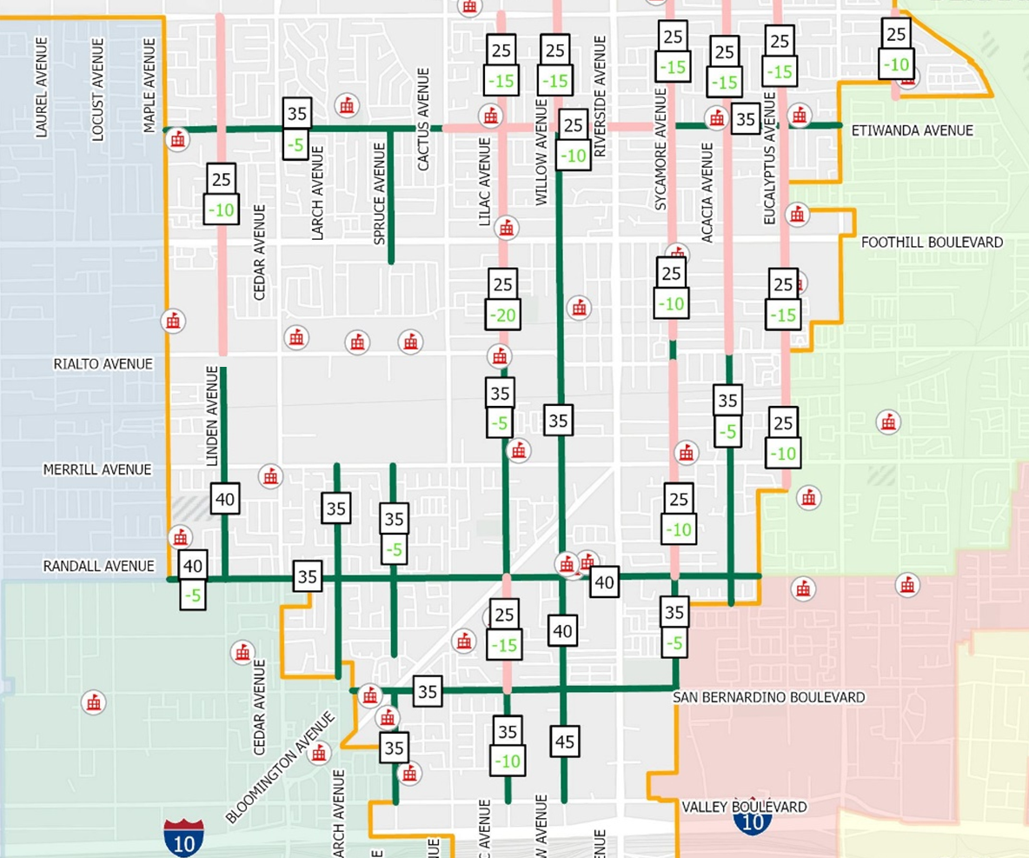
Recommend Collector to Local Street
South of
Etiwanda Ave

Slide 7
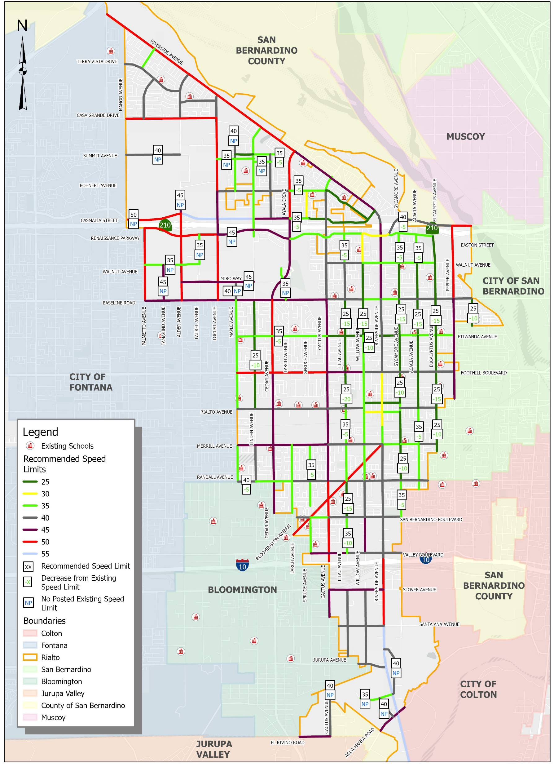
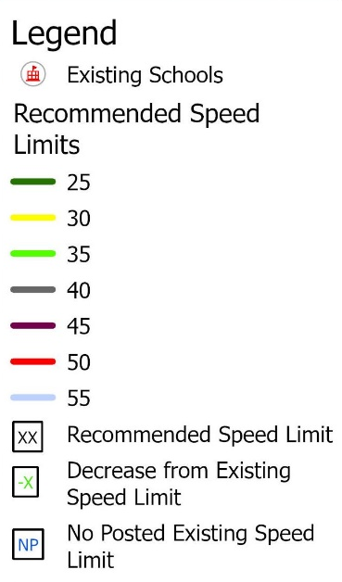
Decreased Speed Limits
North of
Foothill Boulevard

Slide 8
Decreased Speed Limits
South of
Foothill Boulevard

Slide 9
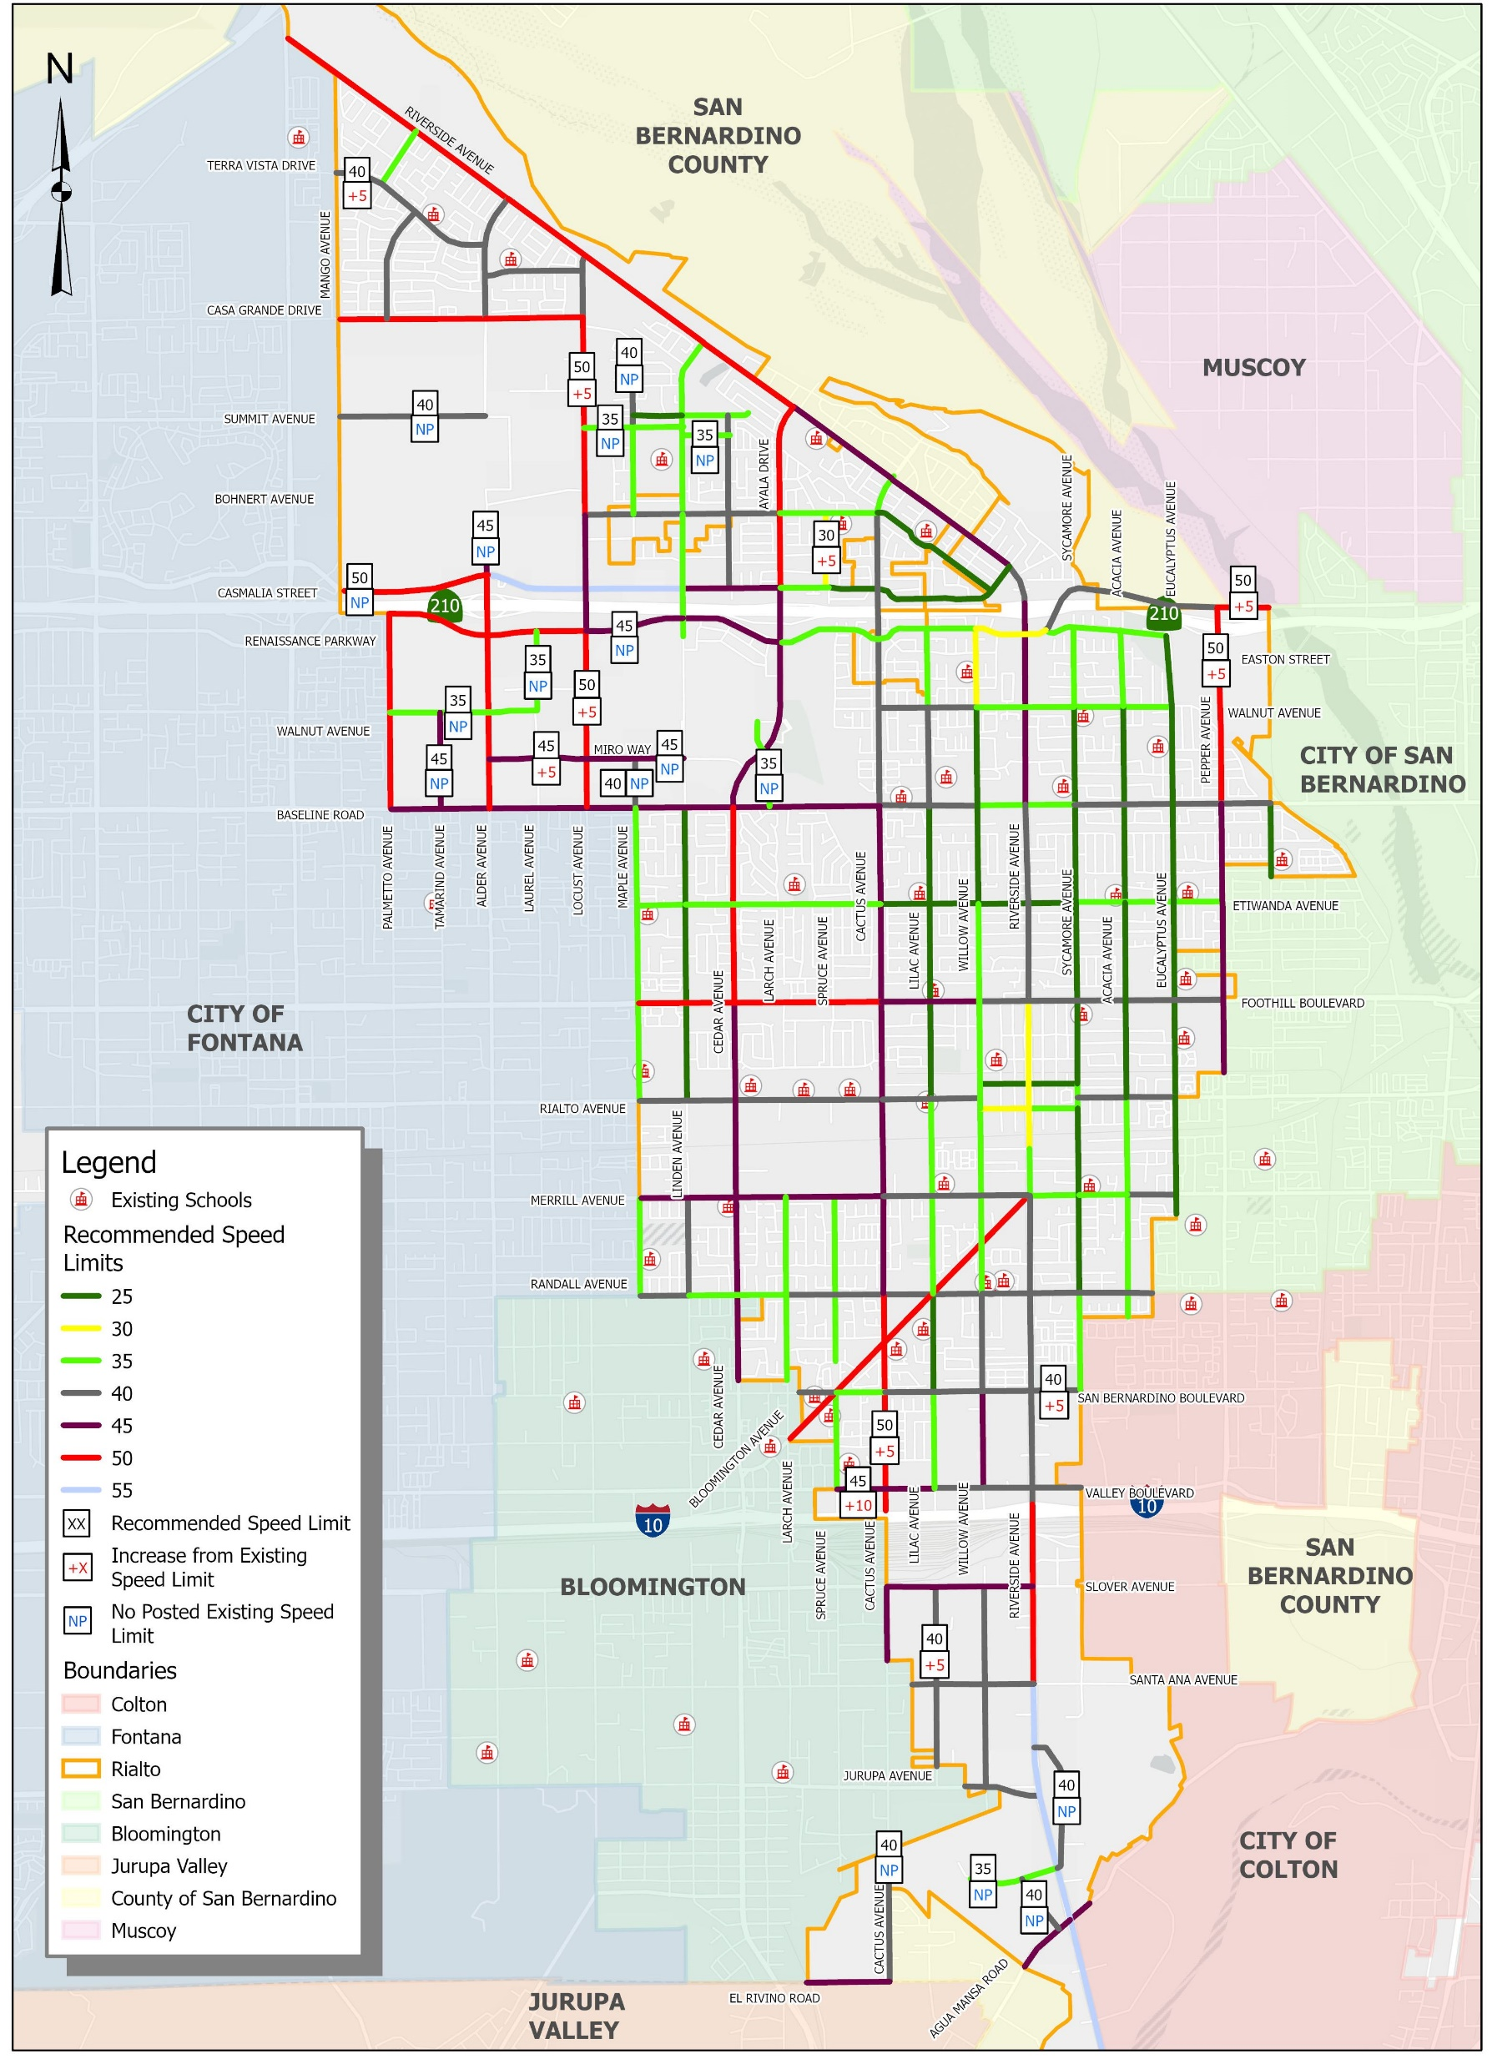
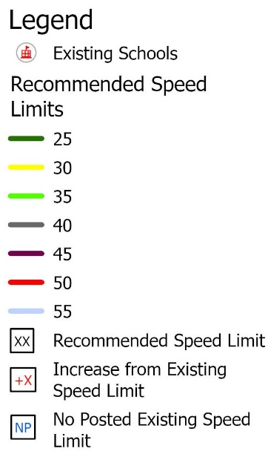
Increased Speed Limits
North of
Foothill Boulevard

Slide 10
Increased Speed Limits
South of
Foothill Boulevard

Slide 11
Recommendation
Staff recommends that the City Council to amending Chapter 10.32- Speed limits to change the speed limits for 60 of 177 roadway segments.
The following summarizes the changes:
  11 speed limits are proposed to be increased
  31 speed limits are proposed to be decreased
    This includes 17 roadway segments that are recommended to be downgraded from Collector Streets to Local Streets
  18 new speed limits will be established to roadway segments with no previous speed limit

