Slide 1
City of Rialto
FISCAL YEAR 2021-22
End of year general fund preliminary financial review
December 13, 2022

Slide 2
City of Rialto
End of Year General Fund Preliminary Financial Review
Original FY 21-22 Budget – General Fund
Total Revenues: $ 104,233,560
Total Expenditures: $ 104,233,560
$ 0 [balanced]
Revised FY 21-22 Budget – General Fund
Total Revenues: $ 141,755,345
Total Expenditures: $ 176,312,123
($34,556,778) [deficit]

Slide 3
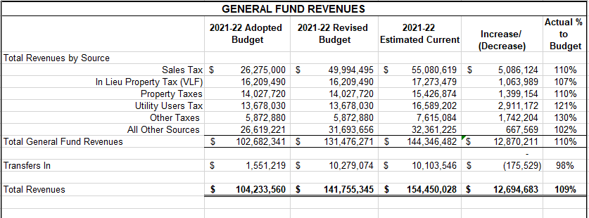
City of Rialto
End of Year General Fund Preliminary Financial Review
Revenue Surplus - $12.7 million
9% Increase

Slide 4
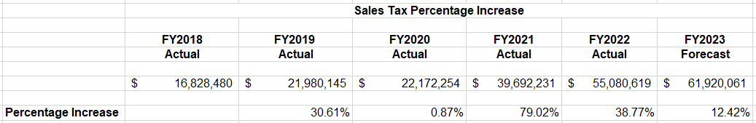
City of Rialto
End of Year General Fund Preliminary Financial Review
Highest Revenue Source
35.67% of Total General Fund Revenue

Slide 5
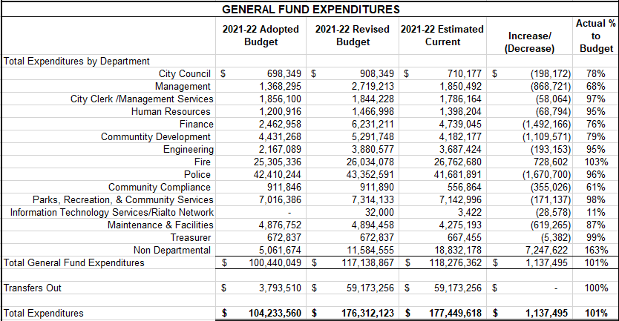
City of Rialto
End of Year General Fund Preliminary Financial Review
Expense Deficit - $1.1 million
Unrealized Market/Valuation Loss - $8.3 million

Slide 6
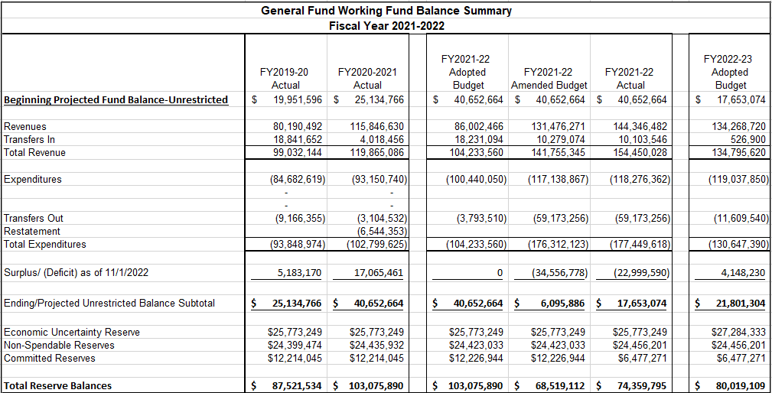
City of Rialto
End of Year General Fund Preliminary Financial Review
One Time Expenses
Street Paving Repairs
  $10,000,000
Vehicle Replacement
  $1,000,000
Worker’s Comp. Fund
  $2,700,000
OPEB
  $10,000,000
New Positions/Modifications
  $500,000

Slide 7
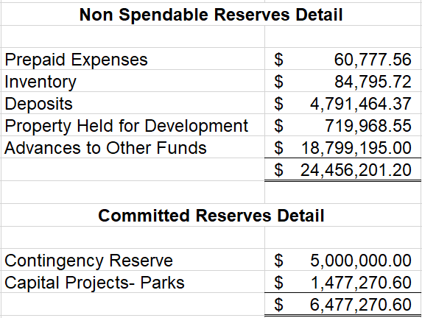
City of Rialto
End of Year General Fund Preliminary Financial Review
Committed Reserves Detail
Contingency Reserve – Resolution 6140 – July 19, 2012
  Redirected funds reserved for the I-10 Riverside Ave. Overpass Project.
Capital Projects/Parks – Resolution 7165 – July 11, 2017
  $1,733,246 set aside for Capital Projects/Parks
  $255,976 used in FY2018-19
  Remaining Balance - $1,477,270.60

Slide 8
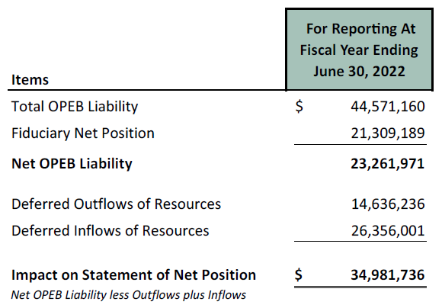
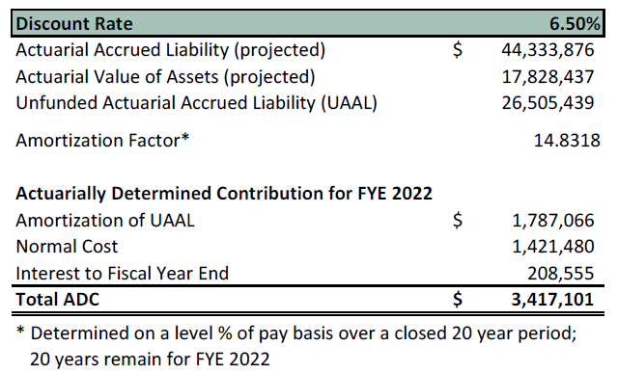
City of Rialto
End of Year General Fund Preliminary Financial Review
Reporting Date - June 30, 2022
Measurement Valuation Date– June 30, 2021
February 25, 2022 - $10,000,000 transferred to OPEB account.
Council Approved – October 26, 2021
Council Approved – February 22, 2022

Slide 9
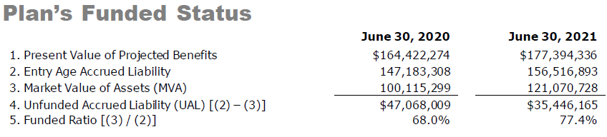
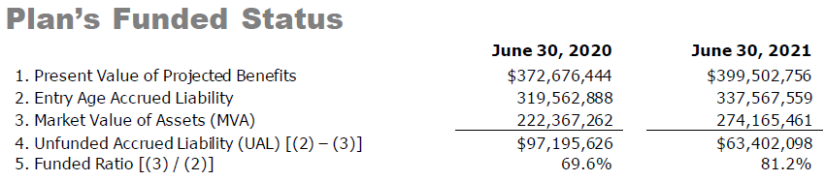
City of Rialto
End of Year General Fund Preliminary Financial Review
Total Unfunded Accrued Liability - $98,848,263
Reporting Date – June 30, 2022
Actuary Date – June 30, 2021

Slide 10
City of Rialto
End of Year General Fund Preliminary Financial Review
Options to Reduce CalPERS Unfunded Accrued Liability
Option 1: Pay to CalPERS to Eliminate Longest Amortization Bases
  Maximizes the total long-term savings to the City of Rialto
  Lowers required Contribution
  Cannot get Contribution back after contributing to CalPERS
Option 2: Pay to CalPERS to Eliminate Shortest Amortization Bases
  Maximizes the short-term reduction in required contributions to the City of Rialto
  Lowers required Contribution
  Cannot get contribution back after contributing to CalPERS
Option 3: Pay to Pension 115 Trust
  This payment, along with interest earned on it would be paid to CalPERS when the payment would get the Plan to 100% funding.
  Assets in Section 115 Pension Trust must be used to make pension contributions.
  Can be used to make some or all the City’s required contribution

Slide 11
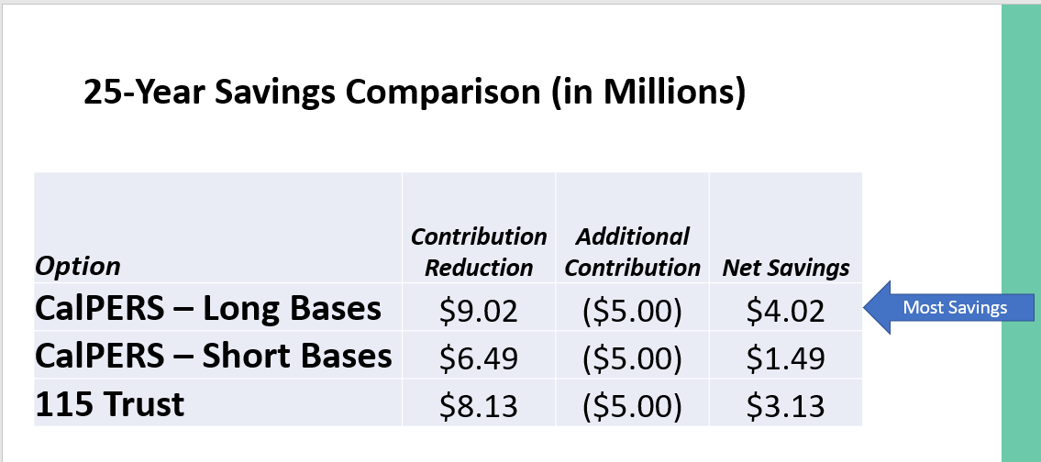
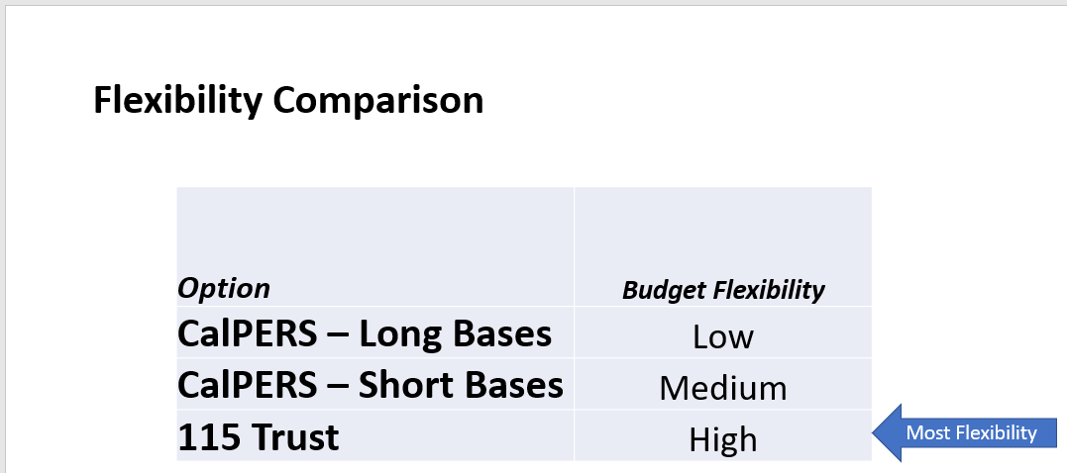
City of Rialto
End of Year General Fund Preliminary Financial Review

Slide 12
City of Rialto
End of Year General Fund Preliminary Financial Review
Staff Recommendations for Consideration
Release the Contingency Reserve of $5 million to unrestricted General Fund reserves as the City is already reserving $25.8 million in the Economic Uncertainty Reserve that was established by Council’s police on July 28, 2020 and direct those funds to a payment against the CalPERS pension Unfunded Accrued Liability to apply towards the longest amortization bases.
Release the Capital Projects – Parks committed reserve of $1.4 million and directing those funds to pay down the General Fund advance loan to the Park Fund for completion of Frisbie Park expansion and Joe Sampson Park.

