Slide 1

City of Rialto
FISCAL YEAR 2023-2024
proposed
Comprehensive budget
Budget workshop
August 17, 2023

Slide 2
City of Rialto
FY 2023-24 Proposed Comprehensive Budget
Agenda
Budget Process Overview
FY 2023-24 General Fund Revenue/Expense Review
FY 2023-24 All Funds Revenue/Expense Review
FY 2023-24 GANN Limit Review
Department Budget Reviews

Slide 3
City of Rialto
FY 2023-24 Proposed Comprehensive Budget
Budget Process Overview
Scheduled Individual Department Meetings
  Detailed Review of Budget Line Items
  Detailed Review of Personnel Budgets
Budget Adjustments were made based on Historical Trends

Slide 4
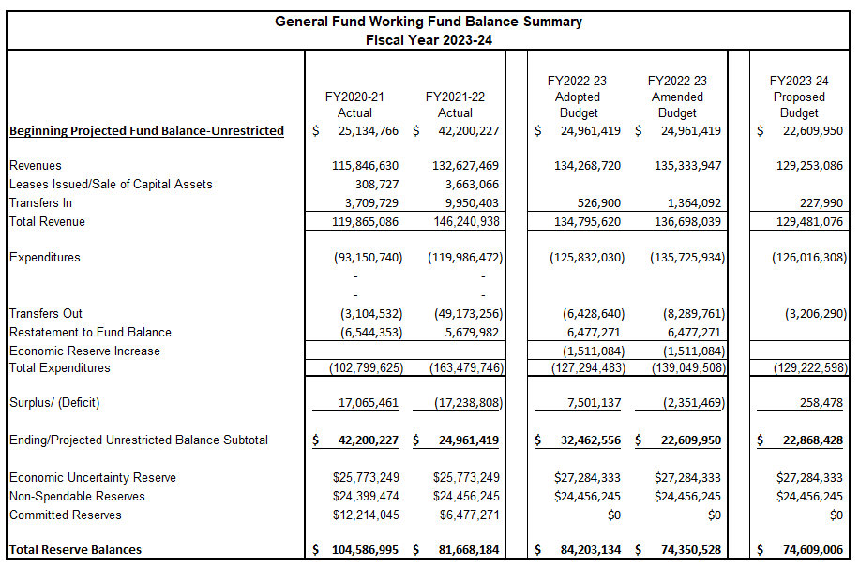
City of Rialto
FY 2023-24 Draft General Fund Budget
General Fund Review
Unrestricted Fund Balance
FY2021-22 - $24,961,419
FY2022-23 - $22,609,950
  Estimate
FY2023-24 - $22,868,428
  Proposed

Slide 5
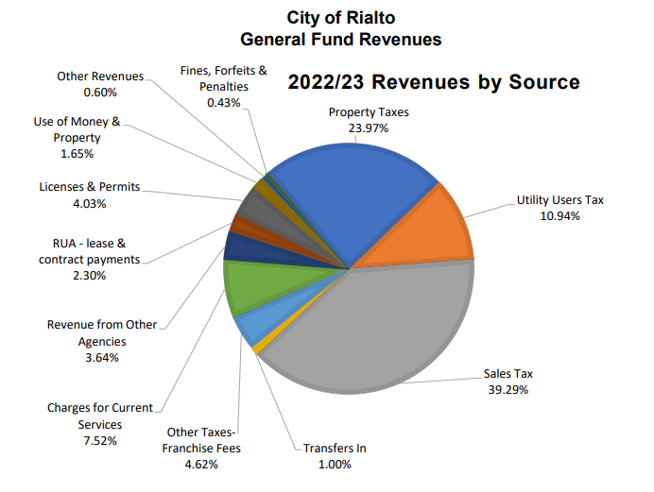
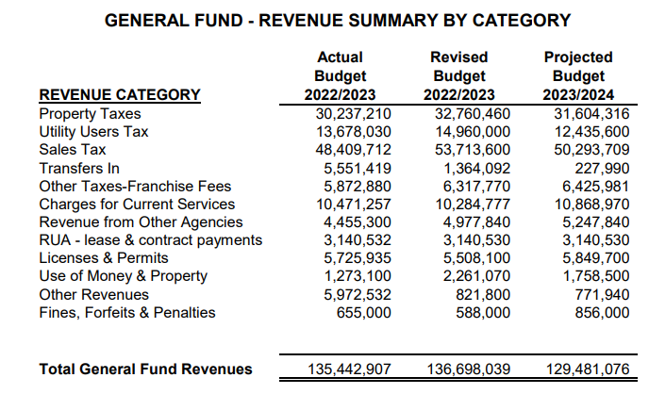
City of Rialto
FY 2023-24 Draft General Fund Budget
FY2023-24 – General Fund Revenue

Slide 6
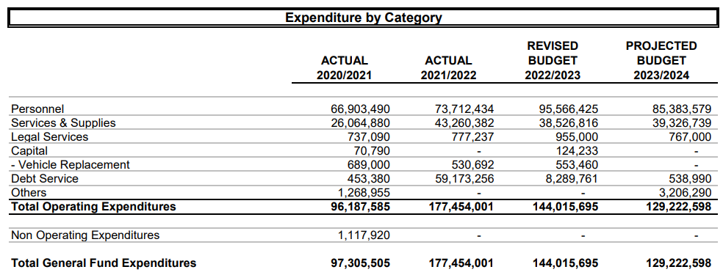
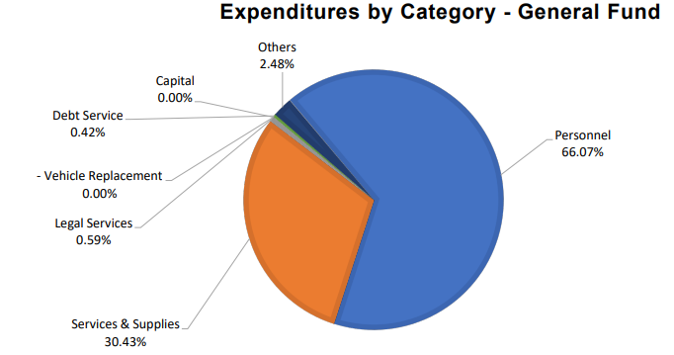
City of Rialto
FY 2023-24 Draft General Fund Budget
FY2023-24 – General Fund Expenses
Personnel – 66.07%
Services & Supplies – 30.43%

Slide 7
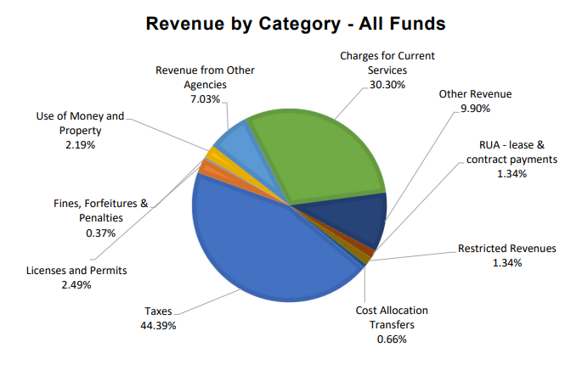
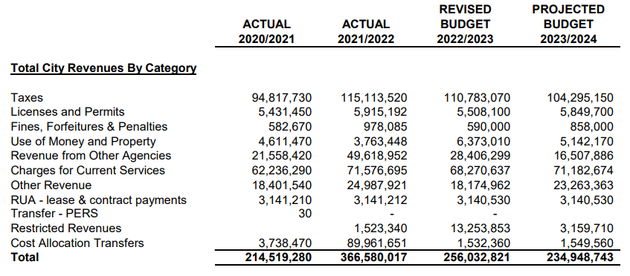
City of Rialto
FY 2023-24 Draft General Fund Budget
FY 2023-24 All Funds Revenue

Slide 8
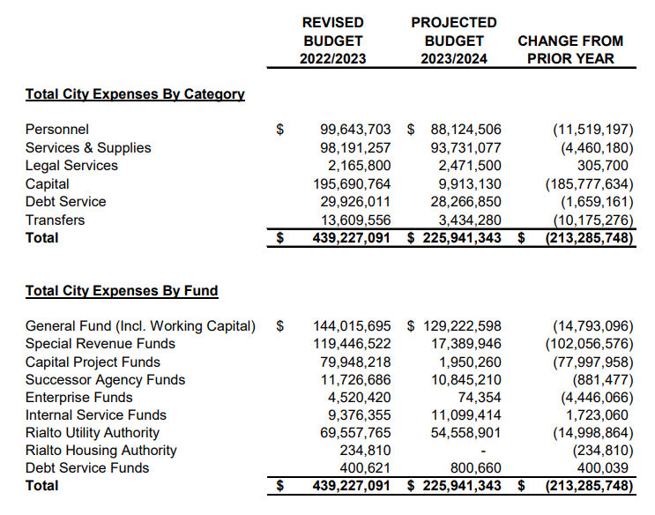
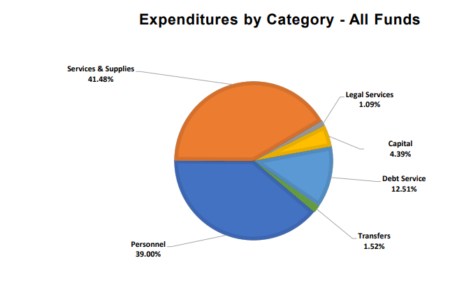
City of Rialto
FY 2023-24 Draft General Fund Budget
FY 2023-24 All Funds Expenses

Slide 9
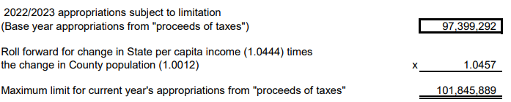

City of Rialto
FY 2023-24 Proposed Comprehensive Budget
FY2023-24 GANN Limit Review

Slide 10
City of Rialto
FY 2023-24 Proposed Comprehensive Budget
City Council
Personnel – No Changes
Council Members - 5 FTE
Part Time – 10,000 Hours
Expenditures – FY23 Revised Budget - $915,242
FY24 Proposed Budget - $1,002,267
Increase from Prior Year- $87,025

Slide 11
City of Rialto
FY 2023-24 Proposed Comprehensive Budget
City Manager
Personnel – No Changes
        Full Time – 6 FTE
    Part Time – 3,000 hours
Expenditures – FY23 Revised Budget - $2,630,047
FY24 Proposed Budget - $1,921,839
Reduction from Prior Year- $708,208

Slide 12
City of Rialto
FY 2023-24 Proposed Comprehensive Budget
City Clerk/Management Services
Personnel – No Changes
        Full Time – 9 FTE
Expenditures – FY23 Revised Budget - $809,322
FY24 Proposed Budget - $511,421
Reduction from Prior Year- $297,901

Slide 13
City of Rialto
FY 2023-24 Proposed Comprehensive Budget
Community Development
Personnel – 1. Reclass Senior Planner to Principal Planner
        Full Time – 25 FTE
    Part Time – 4000 hours
Expenditures – FY23 Revised Budget - $5,148,653
FY24 Proposed Budget - $5,203,160
Increase from Prior Year- $54,507

Slide 14
City of Rialto
FY 2023-24 Proposed Comprehensive Budget
Engineering Department
Personnel – 1. Position Eliminations – Intern PT - 2
        Full Time – 16 FTE
    Part Time – 2000 hours
Expenditures – FY23 Revised Budget - $5,764,624
FY24 Proposed Budget - $5,185,650
Reduction from Prior Year- $578,974

Slide 15
City of Rialto
FY 2023-24 Proposed Comprehensive Budget
Finance Department
Personnel – No Changes
        Full Time – 21 FTE
    Part Time – 3000 hours
Expenditures – FY23 Revised Budget - $5,330,069
FY24 Proposed Budget - $3,048,707
Reduction from Prior Year- $2,281,362

Slide 16
City of Rialto
FY 2023-24 Proposed Comprehensive Budget
Fire Department
Personnel – 1. Reclass Executive Assistant to Community Education and Outreach Specialist
        2. Position Elimination – Senior Office Specialist
        Full Time – 96 FTE
    Part Time – 1000 hours
Expenditures – FY23 Revised Budget - $27,254,128
FY24 Proposed Budget - $24,321,935
Reduction from Prior Year- $2,932,193

Slide 17
City of Rialto
FY 2023-24 Proposed Comprehensive Budget
Human Resources/Risk Management
Personnel – 1. Reclass Deputy Director of HR/Risk Mgmt to Sr HR/Risk Mgmt
        Full Time – 8 FTE
Expenditures – FY23 Revised Budget - $1,838,336
FY24 Proposed Budget - $1,359,200
Reduction from Prior Year- $479,136

Slide 18
City of Rialto
FY 2023-24 Proposed Comprehensive Budget
Information Technology Department
Personnel – No Changes
        Full Time – 12 FTE
    Part Time – 1000 hours
Expenditures – FY23 Revised Budget - $3,797,924
FY24 Proposed Budget - $3,277,887
Reduction from Prior Year- $520,037

Slide 19
City of Rialto
FY 2023-24 Proposed Comprehensive Budget
Maintenance & Facilities
Personnel – Position Eliminations
          1. Fleet Maintenance Lead
          2. Equipment Mechanic
          3. Senior Field Service Worker
        Full Time – 42 FTE
    Part Time – 4,000 hours
Expenditures – FY23 Revised Budget - $11,562,179
FY24 Proposed Budget - $11,730,535
Increase from Prior Year- $168,356

Slide 20
City of Rialto
FY 2023-24 Proposed Comprehensive Budget
Parks, Recreation & Community Services Department
Personnel – 1. New Position – Administrative Aide - PT
        Full Time – 26 FTE
    Part Time – 119,000 hours
Expenditures – FY23 Revised Budget - $8,640,380
FY24 Proposed Budget - $9,078,866
Increase from Prior Year- $438,486

Slide 21
City of Rialto
FY 2023-24 Proposed Comprehensive Budget
Police Department
Personnel – 1. Reclass Police Transcriptionist to Police Records Assistant I/II
        2. Reclass Administrative Aide – PT to Senior Office Specialist
        3. New Position – Police Records Assistant I/II
        Full Time – 199 FTE
    Part Time – 26,000 hours
Expenditures – FY23 Revised Budget - $48,625,260
FY24 Proposed Budget - $42,824,244
Reduction from Prior Year- $5,801,016

Slide 22
City of Rialto
FY 2023-24 Proposed Comprehensive Budget
City Treasurer
Personnel – 1. Reclass Senior Accounting Assistant to
Assistant Treasurer/Accounting Specialist
2. Eliminate Assistant Treasurer/Investment Officer
3. New Position - Office Specialist
        Full Time – 5 FTE
Expenditures – FY23 Revised Budget - $777,910
FY24 Proposed Budget - $558,145
Reduction from Prior Year- $219,765

