Slide 1
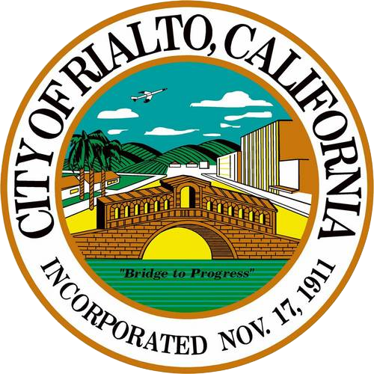
City of RIALTO
Community Development Block Grant
CDBG FY 26-27
Program Overview

Slide 2
Agenda
Timeline
Reporting
CDBG Overview
Eligible Activities
Funding
Application Workshop
Applicant Presentations
Recommendations

Slide 3
Timeline
Due Date | Task
Monday, January 19, 2026 | Notice of Funding Availability(NOFA) issued to City Departments and Community Based Organizations (CBO)
Monday, January 19, 2026 | NOFA Published in newspaper and post on City website
Friday, February 6, 2026 | Application Workshop via zoom at 11AM
Friday, February 20, 2026 | Applications due to City (Public and Non-Public Services)
March 2 - March 13 | Applications reviewed by staff for completeness, eligibility, etc.
Tuesday, April 7, 2026 | Ad-Hoc Committee Meeting: CDBG Subrecipient evaluation and interview of submitted applications
March 30 – April 28 | Notice of Public Hearing & 30-day Comment Period for Annual Action Plan
Tuesday, April 28, 2026 *tentative | City Council conducts Public Hearing for Annual Action Plan
Friday, May 15, 2026 *tentative | Submit Annual Action Plan to HUD

Slide 4
Reporting
Annual Action Plan:
  Outlines the City’s use of its Community Development Block Grant (CDBG) funds each year.
  The one-year Action Plan discusses the specific activities planned for the upcoming fiscal year and the resources available.
  It must be submitted annually and approved by HUD before funds are released. Report is typically due May 15th.

Slide 5
Reporting
Consolidated Plan:
  Five-Year plan for the use of CDBG funds.
  Fiscal Year 2026-2027 is the 2nd Action Plan of the Five-Year Consolidated Planning period (2025-2029).
  Consolidated Plan Goals for 2025-2029:
    Community Facilities and Infrastructure Improvements,
    Public Services for Low-income residents,
    Housing Preservation,
    Fair Housing Services.

Slide 6
Reporting
CAPER:
  Grantees are required to submit a Consolidated Annual Performance and Evaluation Report (CAPER) at the end of each program year to report on the prior year program accomplishments.
  By providing detailed financial and beneficiary information, the CAPER explains how a jurisdiction is carrying out its housing and community development strategies, projects, and activities.
  Report is typically due August 16.

Slide 7
What is CDBG?
    The CDBG Program was initiated by an Act of Congress as a part of the Housing and Community Development Act of 1974.
    The program is funded directly by the Federal government’s Department of Housing and Urban Development (HUD).

Slide 8
CDBG Objectives
Viable urban communities
Principally for low- to moderate-income residents
Decent housing
Suitable living environment
Expanded economic opportunity

Slide 9
Eligible
Activities
Ineligible
Activities
Public services
Housing activities
Public Facilities and Improvements
Economic development
Acquisition, Construction, or Reconstruction of Buildings for the General Conduct of Government
Political Activities
New Housing Construction
Maintenance & Operating Expenses (Local Government)
Equipment Purchases (Local Government)
Political or Religious Proselytizing
Fundraising
Notes:
faith or political doctrine.

Slide 10
CDBG FUNDING
$1,100,000 CDBG anticipated allocation for FY 2026-2027 *
Up to 20% - Program Administration
Up to 15% - Public Services
  Educational & Employment Programs
  Legal Advocacy
  Mobile Food Distribution Programs
  Veterans Assistance Programs
Remainder – non-public service activities
  Infrastructure Improvements
  Park Improvements
HUD
Rialto
Subrecipient
Contractor, CBDO
Beneficiary

Slide 11
CDBG FUNDING
Activity | Allocation
FY 26-27 CDBG Anticipated Allocation | $ 1,100,000.00
Carry Over | $ -
Total Available to Program | $ 1,100,000.00
Activity | Allocation
CDBG Administration (20% Allocation) | $ 220,000.00
CDBG Public Services (15% Allocation) | $ 165,000.00
Section 108 Loan Repayment | $ 143,791.10
Available for Non-Public Services | $ 571,208.90
*Projected allocation based on last FY’s grant

Slide 12
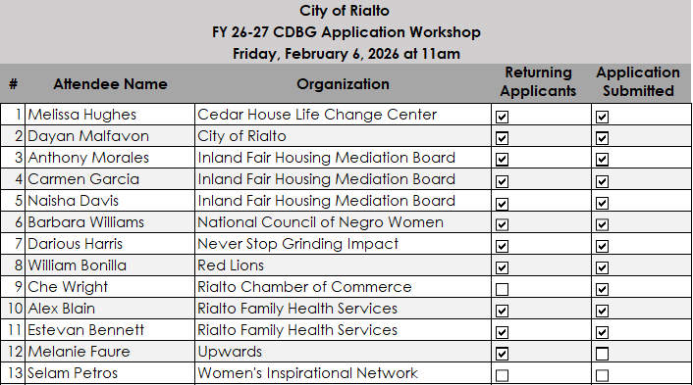
Application Workshop

Slide 13
FY 26-27 CDBG Program Applicant Presentations
Notes:
Now we can transition to the FY 2026-2027 Applicant Presentations.

Slide 14
FY 26-27 CDBG – Administration Funding Requests
20% Cap of Total Allocation = $ 220,000
Organization | Program | FY 25-26 Allocation | FY 26-27 Requested
Inland Fair Housing and Mediation Board | Fair Housing Services | $35,000.00 | $35,000
Remaining CDBG Program Administration Funds |  | $185,000.00

Slide 15
FY 26-27 CDBG – Public Services Funding Requests
15% Cap of Total Allocation = $165,000
Organization | Program | FY 25-26 Allocation | FY 26-27 Requested
National Council of Negro Women | NCNW Bethune Center | $21,705.00 | $42,000.00
Never Stop Grinding Impact | Impactful Emotional Teaching Boxing | $45,000.00 | $45,000.00
Red Lions FC | Youth Soccer Program | N/A | $8,000.00
Rialto Family Health Services | Veterans Programs | $5,000.00 | $40,000.00
City of Rialto | Paddleboard Yoga | N/A | $8,000.00
City of Rialto | Senior Mobile Recreation | $8,000.00 | $8,000.00
City of Rialto | Sensory Room | $35,000.00 | $30,000.00
City of Rialto | Teen Center | N/A | $10,675.00
Public Services Total |  |  | $191,675.00

Slide 16
FY 26-27 CDBG – Non-Public Services Funding Requests
Non-Public Services - Anticipated Allocation - $ 715,000
Organization | Program | FY 26-27 Requested
City of Rialto | Curb, Gutter, Sidewalk | $ 200,000.00
City of Rialto | Mobile Home Rehabilitation | $ 60,000.00
City of Rialto | Section 108 Loan Repayment (Required Funding) | $ 143,791.10
City of Rialto Police Department | Public Safety Camera and Crime Prevention Infrastructure Project | $ 490,000.00
Rialto Chamber of Commerce | Route 66 Centennial Small Business Hop & Workforce Development Initiative | $ 50,000.00
Non-Public Services Total |  | $ 943,791.10

