Slide 1

Office of Housing and Community Development
FY 2025
Accomplishments & Impact Overview

Slide 2
Community Development Block Grant (CDBG) Investments
Hollywood Boys & Girls Club (1109–1111 N. 69 Way)
Bob Butterworth Park
(5202 Washington Street)
$250,000 allocated to the expansion and construction of a new Teen Center.
Total project cost: $1.5 million
$240,000 invested in the development of the COVID Memorial
Public Infrastructure Improvements
Proposed Future CDBG Funded Projects include an estimated $600,000 to Public Works for streetlights and $400,000 to Parks, Recreation & Cultural Arts for parks equipment

Slide 3
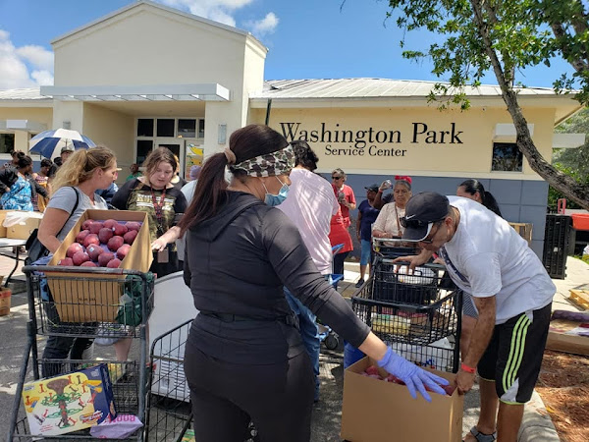
Public Services (CDBG & CDBG-CV)
$237,000 ($175,000 in CDBG & $62,000 CDBG-CV Funding)invested in public services supporting low- to moderate-income residents
9 nonprofit organizations funded, providing:
Food assistance for seniors
Tutoring and STEM education for youth
Essential supportive services for vulnerable populations
Notes:
More than 2,800 individuals served through City-funded homeless and public service programs

Slide 4
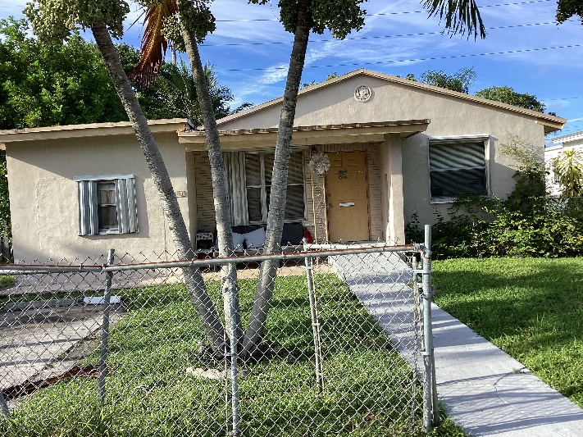
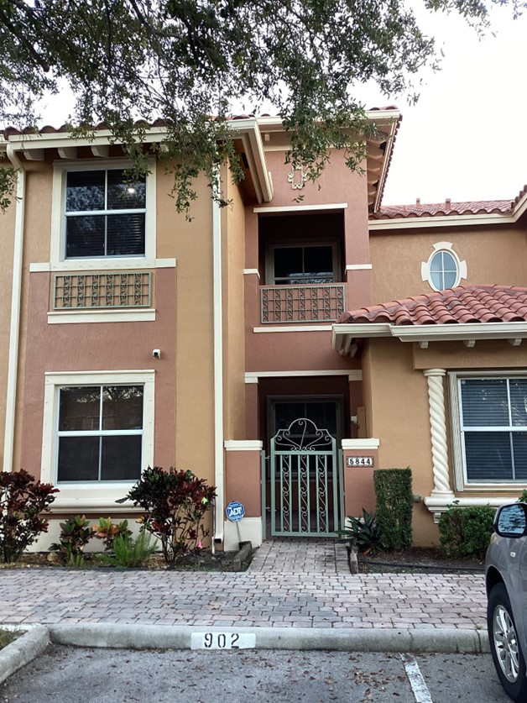
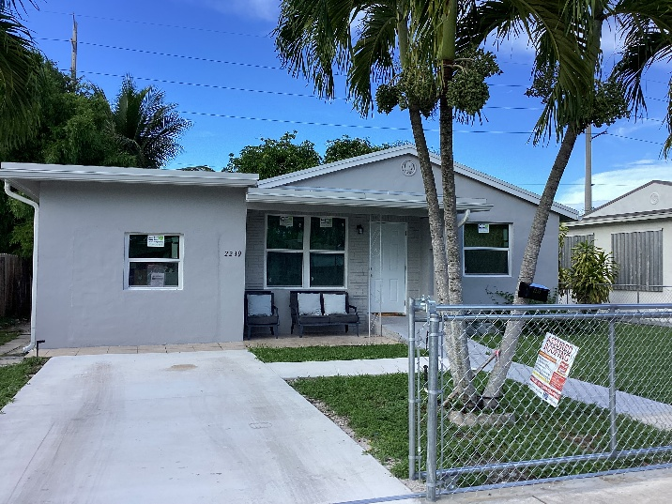
Owner-Occupied Rehabilitation (SHIP & ILA)
64 homes funded through ILA
28 homes funded through SHIP
Approximately 70% of our rehabs are ILA related
$2,560,000 in ILA invested in preserving existing housing stock
$1,584,263.40 in SHIP invested in preserving existing housing stock
First-Time Homebuyer Assistance (ILA)
9 households assisted in achieving homeownership
$416,300 invested
BEFORE
AFTER
AFTER

Slide 5
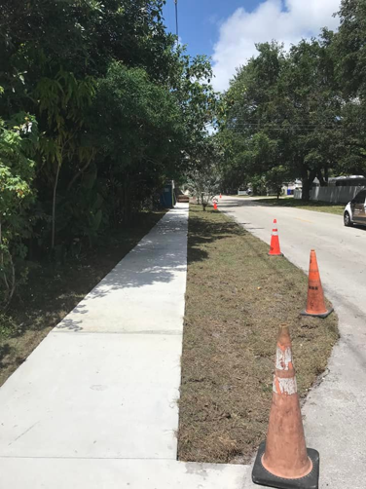
Infrastructure Improvement Program (ILA)
96,717 SF of 4-inch sidewalks
$1,649,867 invested
208,081 SF of 6-inch sidewalks
5,717 SF of ADA detectable warnings and curb improvements

Slide 6
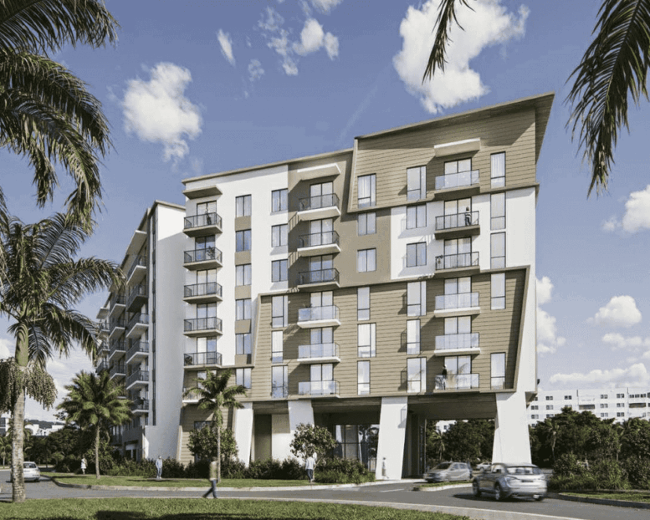
Affordable Housing Development (ILA– GAP Financing)
Estimated 862 affordable housing units supported
$9,027,717 expended to date
$1,280,000 encumbered (Hillcrest Village & Residences at Beverly Place)

Slide 7
HOME Program
Homelessness & Supportive Services (HOME-ARP (American Rescue Plan)
$100,000 to conduct the City of Hollywood Housing Study and Needs Assessment
Tenant-Based Rental Assistance
• Assisted approximately 40 households (serving 250+ individuals)
• Provided critical rental assistance to individuals and families experiencing or at risk of homelessness, helping to stabilize housing situations
$150,000 allocated to the Taskforce for Ending Homelessness
O Supporting street outreach and transitional services for the unsheltered population
$390,000 provided to Broward Outreach Center (The Caring Place)
O Emergency shelter
O Case management
O Workforce development
O Housing placement services
Notes:
Housing Needs Study, as part of the City’s Comprehensive Plan, will help identify current and future housing needs, gaps in services, and inform strategic planning for housing and supportive service development.

Slide 8
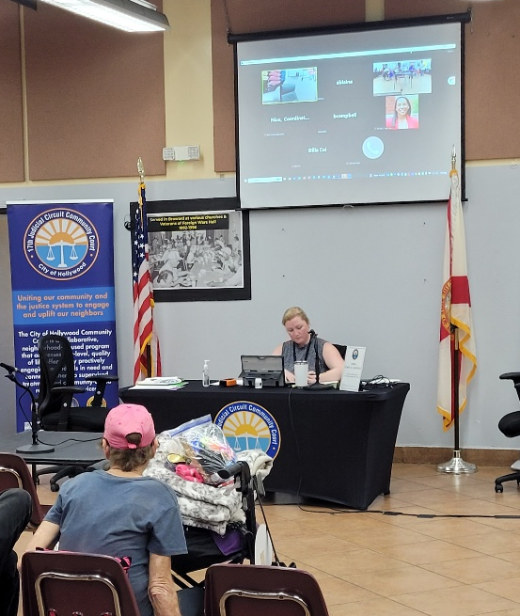
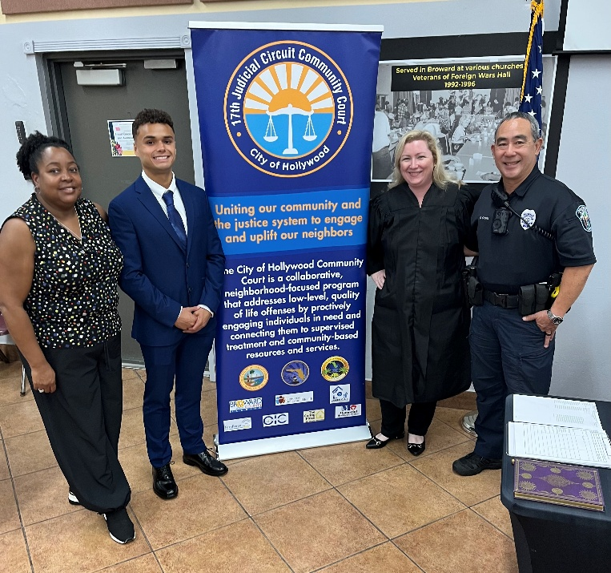
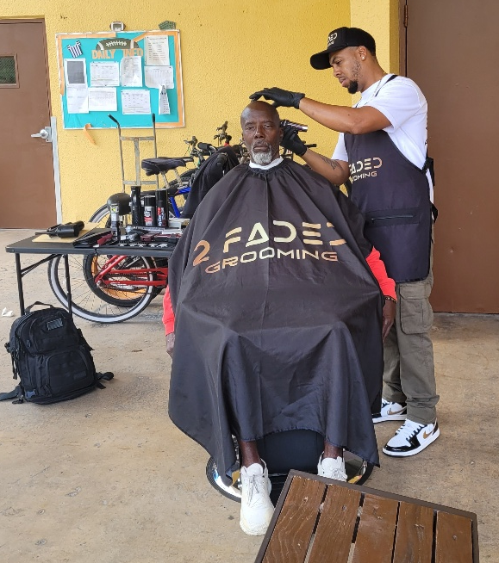
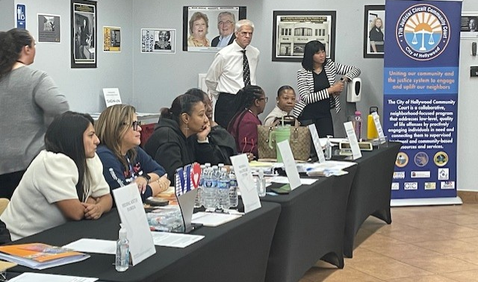
Community Court Program (U.S. Department of Justice Funded)
Hollywood Community Court operating in its 3rd year
88 Notices to Appear issued
383 walk-in clients served this year
21 program graduates who obtained housing
Program Outcomes
726 total clients served &1,349 service referrals provided, connecting individuals to critical supportive services since program inception
Notes:
Administered by the Office of Housing and Community Development in coordination with:
O Hollywood Police Department
O Hollywood Fire Department
O 17th Judicial Circuit
O Broward County
O Broward Sheriff’s Office
O Local service providers

Slide 9
Through strategic investments and strong partnerships, the Office of Housing and Community Development continues to:
Preserve and expand affordable housing
Improve neighborhood infrastructure
Support vulnerable populations
Enhance overall community stability
These efforts collectively move the City of Hollywood forward in its mission to be a resilient and sustainable City that nurtures quality living and fosters a healthy environment where everyone can prosper
Notes:
On behalf of the CDAB, I would like to extend our sincere appreciation for the confidence you have in us to evaluate and make recommendations on behalf of the community. Community Development provide vital services and is truly valuable to the city and we are honored to be part of the process. Thank you.

Slide 10
FY 2025 Highlights
Rebuilding Together Broward Day of Service
8th Annual Homeless Symposium Hosted by Hollywood (First time)
National Community Development Week Proclamation
Housing Presentations to Seniors & Civic Associations
Providing Program Accessibility for Homebound Residents
Community Development Advisory Board Public Hearings
Affordable Housing Advisory Committee Incentive Strategies and Housing Needs
Housing Programs Presentation to Code Compliance
HCD Staff Donations and Volunteering
City Manager’s Team Diamond Award - 2025
Notes:
These highlights only capture some of the various services Housing and Community Development provides or participates in on an ongoing basis. Our team includes technical professionals and the culture in our office is positive, collaborative with a genuine team spirit. We deal with a myriad of residents and others on a daily basis who may be experiencing mental health or other issues, which is often times challenging, but our team handles each situation with professionalism and empathy. If residents are not eligible for certain services, our team always provides alternate resources as a practice to ensure residents feel valued.
Our team was honored with the City Manager’s Team Diamond Award and we strive each day to reflect the sentiment of the honor by going above and beyond to serve the public, work collaboratively with other departments, strategically budget and to administer the programs efficiently while remaining in compliance with our various federal, state and county funding sources.

